Slide 1


Advanced Computer Architecture Fall 2020
Hamed Farbeh
farbeh@aut.ac.ir
Department of Computer Engineering
Amirkabir University of Technology
Lecture 3

Slide 2
Copyright Notice
Lectures adopted from
Computer Architecture: A Quantitative Approach, 5th edition, John L. Hennessy,‎ David A. Patterson, MK pub., 2019
Advanced Computer Architecture-Fall 2020, AUT, Tehran, Iran

Slide 3
Computer Architecture
A Quantitative Approach, Sixth Edition
Chapter 2
Memory Hierarchy Design

Slide 4
Memory Hierarchy Basics
Introduction
Six basic cache optimizations:
Larger block size
Reduces compulsory misses
Increases capacity and conflict misses, increases miss penalty
Larger total cache capacity to reduce miss rate
Increases hit time, increases power consumption
Higher associativity
Reduces conflict misses
Increases hit time, increases power consumption
Higher number of cache levels
Reduces overall memory access time
Giving priority to read misses over writes
Reduces miss penalty
Avoiding address translation in cache indexing
Reduces hit time

Slide 5
Advanced Optimizations
Reduce hit time
Small and simple first-level caches
Way prediction
Increase bandwidth
Pipelined caches, multibanked caches, non-blocking caches
Reduce miss penalty
Critical word first, merging write buffers
Reduce miss rate
Compiler optimizations
Reduce miss penalty or miss rate via parallelization
Hardware or compiler prefetching
Advanced Optimizations

Slide 6
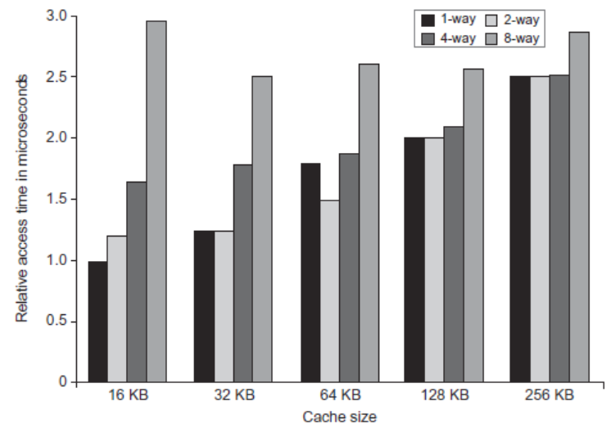
L1 Size and Associativity
Advanced Optimizations
Access time vs. size and associativity

Slide 7
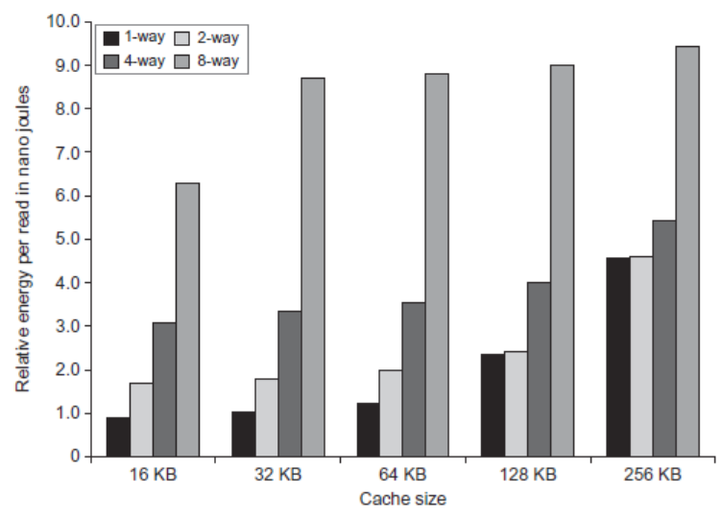
L1 Size and Associativity
Advanced Optimizations
Energy per read vs. size and associativity

Slide 8
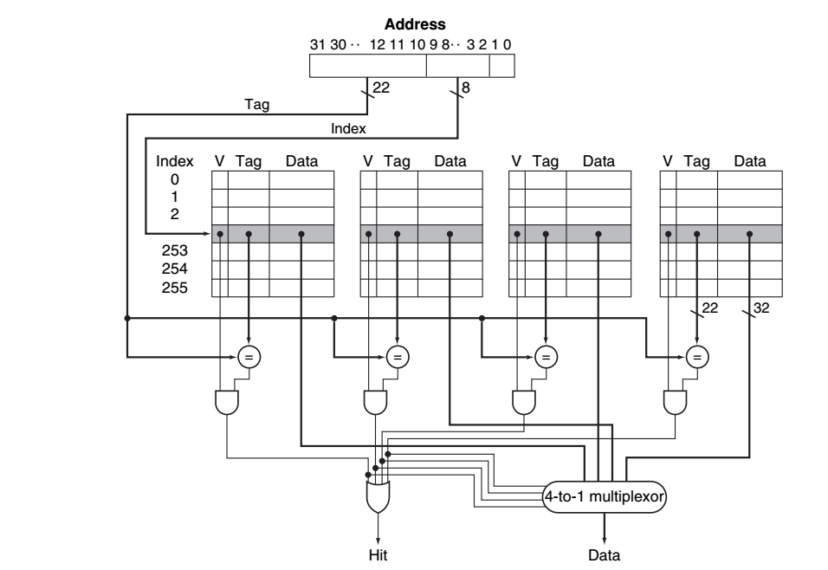
Parallel Access
Advanced Optimizations

Slide 9
Pipelined Caches
Pipeline cache access to improve bandwidth
Examples:
Pentium: 1 cycle
Pentium Pro – Pentium III: 2 cycles
Pentium 4 – Core i7: 4 cycles
Increases branch mis-prediction penalty
Makes it easier to increase associativity
Advanced Optimizations

Slide 10
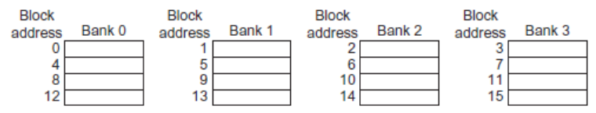
Multibanked Caches
Organize cache as independent banks to support simultaneous access
ARM Cortex-A8 supports 1-4 banks for L2
Intel i7 supports 4 banks for L1 and 8 banks for L2
Interleave banks according to block address
Advanced Optimizations

Slide 11
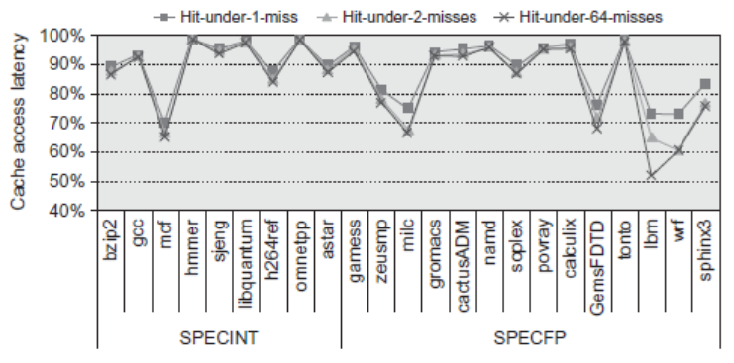
Nonblocking Caches
Allow hits before previous misses complete
“Hit under miss”
“Hit under multiple miss”
L2 must support this
In general, processors can hide L1 miss penalty but not L2 miss penalty
Advanced Optimizations

Slide 12
Critical Word First, Early Restart
Critical word first
Request missed word from memory first
Send it to the processor as soon as it arrives
Early restart
Request words in normal order
Send missed work to the processor as soon as it arrives
Effectiveness of these strategies depends on block size and likelihood of another access to the portion of the block that has not yet been fetched
Advanced Optimizations

Slide 13
Compiler Optimizations
Loop Interchange
Swap nested loops to access memory in sequential order
Blocking
Instead of accessing entire rows or columns, subdivide matrices into blocks
Requires more memory accesses but improves locality of accesses
Advanced Optimizations

Slide 14
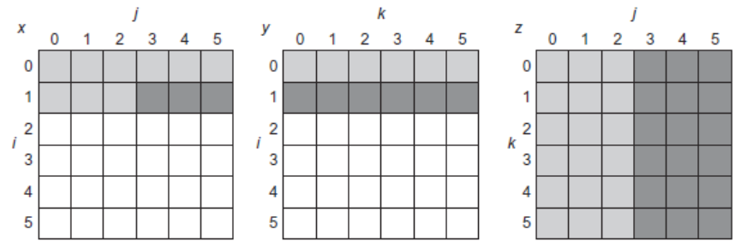
Blocking
for (i = 0; i < N; i = i + 1)
for (j = 0; j < N; j = j + 1)
{
r = 0;
for (k = 0; k < N; k = k + 1)
r = r + y[i][k]*z[k][j];
x[i][j] = r;
};

Slide 15
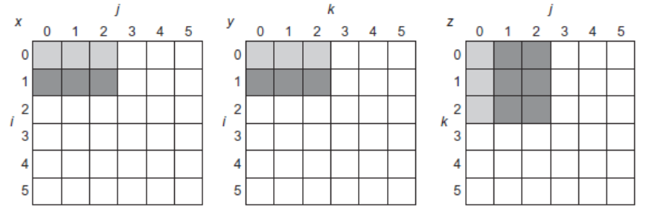
Blocking
for (jj = 0; jj < N; jj = jj + B)
for (kk = 0; kk < N; kk = kk + B)
for (i = 0; i < N; i = i + 1)
for (j = jj; j < min(jj + B,N); j = j + 1)
{
r = 0;
for (k = kk; k < min(kk + B,N); k = k + 1)
r = r + y[i][k]*z[k][j];
x[i][j] = x[i][j] + r;
};

Slide 16
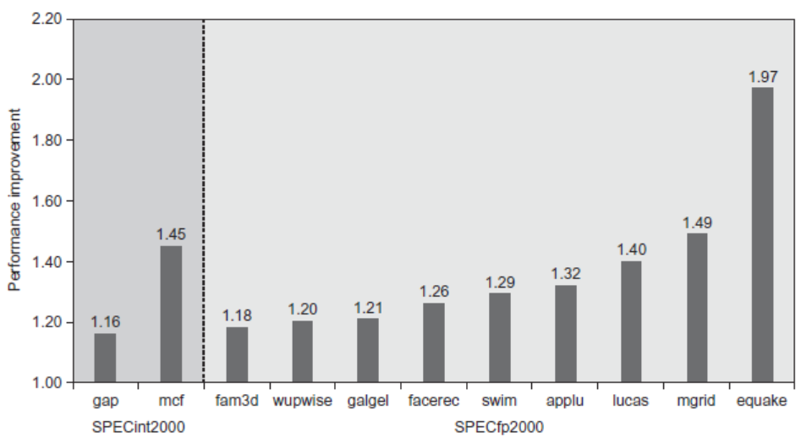
Hardware Prefetching
Fetch two blocks on miss (include next sequential block)
Advanced Optimizations
Pentium 4 Pre-fetching

Slide 17
Compiler Prefetching
Insert prefetch instructions before data is needed
Non-faulting: prefetch doesn’t cause exceptions
Register prefetch
Loads data into register
Cache prefetch
Loads data into cache
Combine with loop unrolling and software pipelining
Advanced Optimizations

